Slide 1
Client Name
Notes:
This presentation is being presented by Aptia365. My name is ____________ and I am happy to be here with you today!

Slide 2
Commuter benefits
Notes:
Thank you for joining us today to cover your company’s sponsored Commuter plan.

Slide 3
Benefits - Transit
Pay for transportation to and from work – tax free
Contribute up to $325 a month (pre-tax)
Make post-tax contributions at any time
Public transportation such as train, bus, subway, vanpool (vehicle that seats six or more adults, excluding the driver), ferry, etc.
Notes:
Why should you choose commuter benefits?
Commuter benefits allow you to put money from your paycheck aside each month, before taxes are taken out, for qualified mass transit and parking expenses.
You will experience fast savings, you can save 40% or more on your costs commuting to and from work.
You will also get hours back in your day, the average one way commute to work is nearly 30 minutes! By using public transit, you can use that time to read news, text friends or family, or simply get a start on your day.
Studies have also shown that people who commute to and from work in a method other than a private vehicle are less stressed.
Enrolling in the commuter plan also makes an impact on the environment, doing your part to reduce traffic congestion and air pollution.

Slide 4
What does the plan cover?
Train
Bus
Subway
Ferry
Vanpool
*Must seat six adults
Parking or parking meter
*Near your place of employment
Notes:
What does the commuter plan cover? Commuter funds can be used on a variety of transportation and parking expenses that allow you to travel to and from work.
Eligible modes of transportation include but aren’t limited to:
Train
Bus
Subway
Ferry
Vanpool (must seat at least 6 adults)
Parking or parking meter near your place of employment

Slide 5
Annual contribution limit
2025 commuter benefit maximum per month:
Transit:
Parking:
$325
$325
Any money contributed to your transit or parking benefit rolls over every month until it’s used or you are no longer eligible.
Notes:
The IRS sets the maximum dollar amount you can elect and contribute to the commuter and parking plan.
The 2025 limit is $325 per month for both transit and parking.
We recommend reviewing how much you spend on eligible expenses every year to determine how much to elect.

Slide 6
Smart commute
Notes:
Now let’s talk about smart commute.

Slide 7
Smart commute
For those in Chicago, San Francisco, and Washington D.C.
Step 1
Step 2
Step 3
Step 4
^{Enroll in mass transit plan.}
Purchase a smart card from your transit authority in Atlanta*, Chicago, San Francisco, or Washington D.C.
Log in to your online account, go to the commuter page, and load your pre-tax dollars onto your smart card by clicking “New Order.” You must do this at least a month in advance.
Pre-tax dollars are available on the smart card on the 1st of the benefit month. You can begin spending!
Notes:
Those eligible for Smart commute can load commuter funds onto transit cards through a commuter page in their online account each month. It’s easy! Just click the “Place Commuter Order” button to access Smart commute, click the “New Order” button and follow a few simple steps.
Smart commute orders must be placed by 11:59 p.m. Eastern time on the 10th of the month prior to the balance being used for commuter funds to be accessible on your transit cards. If this deadline isn’t met, funds won’t be loaded onto transit cards.

Slide 8
Accessing your funds
Benefits card
Cash reimbursement available for parking
File the parking claims through your online account or mobile app
^{No documentation required}
Notes:
You can access your commuter funds by using your benefits card or by filing a claim for reimbursement through your mobile app.

Slide 9
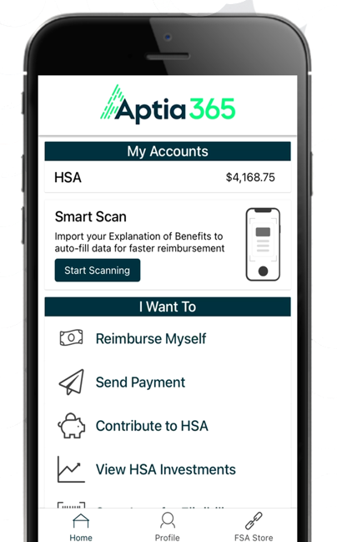
With our mobile app you can:
Get instant updates on the status of your claims.
File a claim and upload documentation in seconds using your phone’s camera.
Security on the go
Our mobile apps use encryption and will not store pictures on your phone, keeping your documentation safe and secure.
Report a card as lost or stolen, which cancels the card and ships you a new one.
Log in through facial recognition or fingerprint (depending on your phone).
Check your balance and view account activity.
Scan an item’s barcode to determine if it is an IRS code section 213(d) eligible expense.
Download the app for free on Apple and Android smartphones and tablets.
Reset login credentials.
Notes:
The Accounts by Aptia365 Mobile App provides you with quick easy access to your online account. After logging in the first time, you can set up fingerprint access right from your phone.
Other great features include:
Take a photo of your explanation of benefits or itemized receipt in order to submit documentation for any outstanding claims. This saves a ton of time since you don’t have to scan an email receipt and upload it manually.
Easily check your account balance while standing in line at the store, making it easy to decide if you want to use your FSA dollars to cover a purchase.

Slide 10
Contact Participant Services
^{Live Chat}
Our Participant Services team is available Monday through Friday, from 6 a.m. to 9 p.m. CST, except holidays.
^{Online Account}
Submit your questions via the Contact Us Form
^{Phone}
^{Toll-Free: 877-248-0510}
Notes:
Our participant services team is available to you Monday through Friday from 6 a.m. to 9 p.m. Central time.
You have a variety of options when contacting us.
You can use the CHAT feature or submit your questions by logging into your online account.
You can call us and check your balance using the automated system.
If participates ask for instructions…
Live Chat: from your online account, select Need Help? in the bottom right corner, which will open a virtual assistant window, then follow prompts.
Submit a question from your online account,
Select Contact Us
Under Quick Links, select Contact Us Form.
Complete the form.
A successful submission message will appear indicating that we'll be in touch.
The employee/participant will receive an email response with additional details or resolution to their inquiry.
Form URL: https://wexhealthinc.my.site.com/aptia/s/MMX

Slide 11
Thank you

